Slide 1
Once faculty have been identified to participate in a CME activity, they will receive a letter of invite to be completed.
If an honorarium is to be paid, the signed letter of agreement should be attached to the contract.
CME Compliance: Letters of Invite

Slide 2
CME Compliance: Letters of invite
Collecting faculty letters of invite from each presenter at your CME activity serves the following purposes:
Outlines the terms of their participation
Collects talk title, learning objectives and contact information

Slide 3
CME Compliance: Letters of Invite
Informs presenters of the LSU conflict of interest policy
Describes how commercial support is controlled and managed for all CME activities
Acts as an official agreement to participate
Includes the ACCME statement of content validity

Slide 4
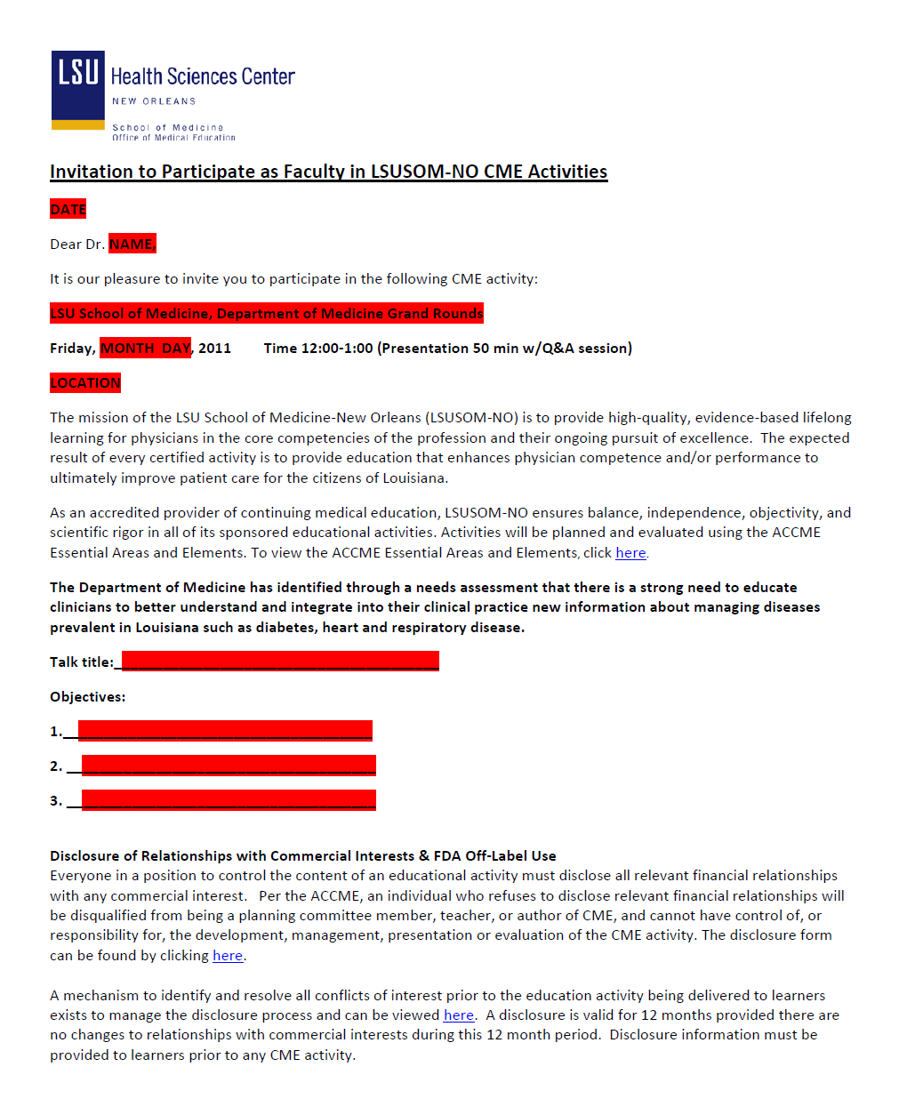
CME Compliance: Letters of Invite
The CME office has templates of faculty letters of invite that can be tailored to your activity.

Slide 5
CME Compliance: Letters of Invite
Post-Test: Invitation letters
True or False:
If you have made a verbal agreement to speak
at a CME activity, that is all you need to do
before delivering your talk.

Slide 6
CME Compliance: Letters of Invite
Post-Test: Invitation letters
True or False:
If you have made a verbal agreement to speak
at a CME activity, that is all you need to do
before delivering your talk.
False. All potential faculty must complete and sign an invitation letter which outlines the terms of their participation.

Slide 7
CME Compliance: Letters of Invite
Post-Test: Invitation letters
Which of the following purposes does the letter
of invite NOT serve?
To outline the conflict of interest policy
To act as an official agreement to participate
To indicate how much the faculty will be paid
To describe how commercial support is managed

Slide 8
CME Compliance: Letters of Invite
Post-Test: Invitation letters
Which of the following purposes does the letter
of invite NOT serve?
To outline the conflict of interest policy
To act as an official agreement to participate
To indicate how much the faculty will be paid
To describe how commercial support is managed
Discussion of any honoraria should be done on a separate
contract. The invitation letter will be attached to the contract as an addendum per LSUHSC contract guidelines.

Slide 9
CME Compliance: Letters of Invite
QUESTIONS?
Please contact the LSU CME office at (504) 568-2000 or email Doug Grigsby at dgrigs@lsuhsc.edu

